Slide 1

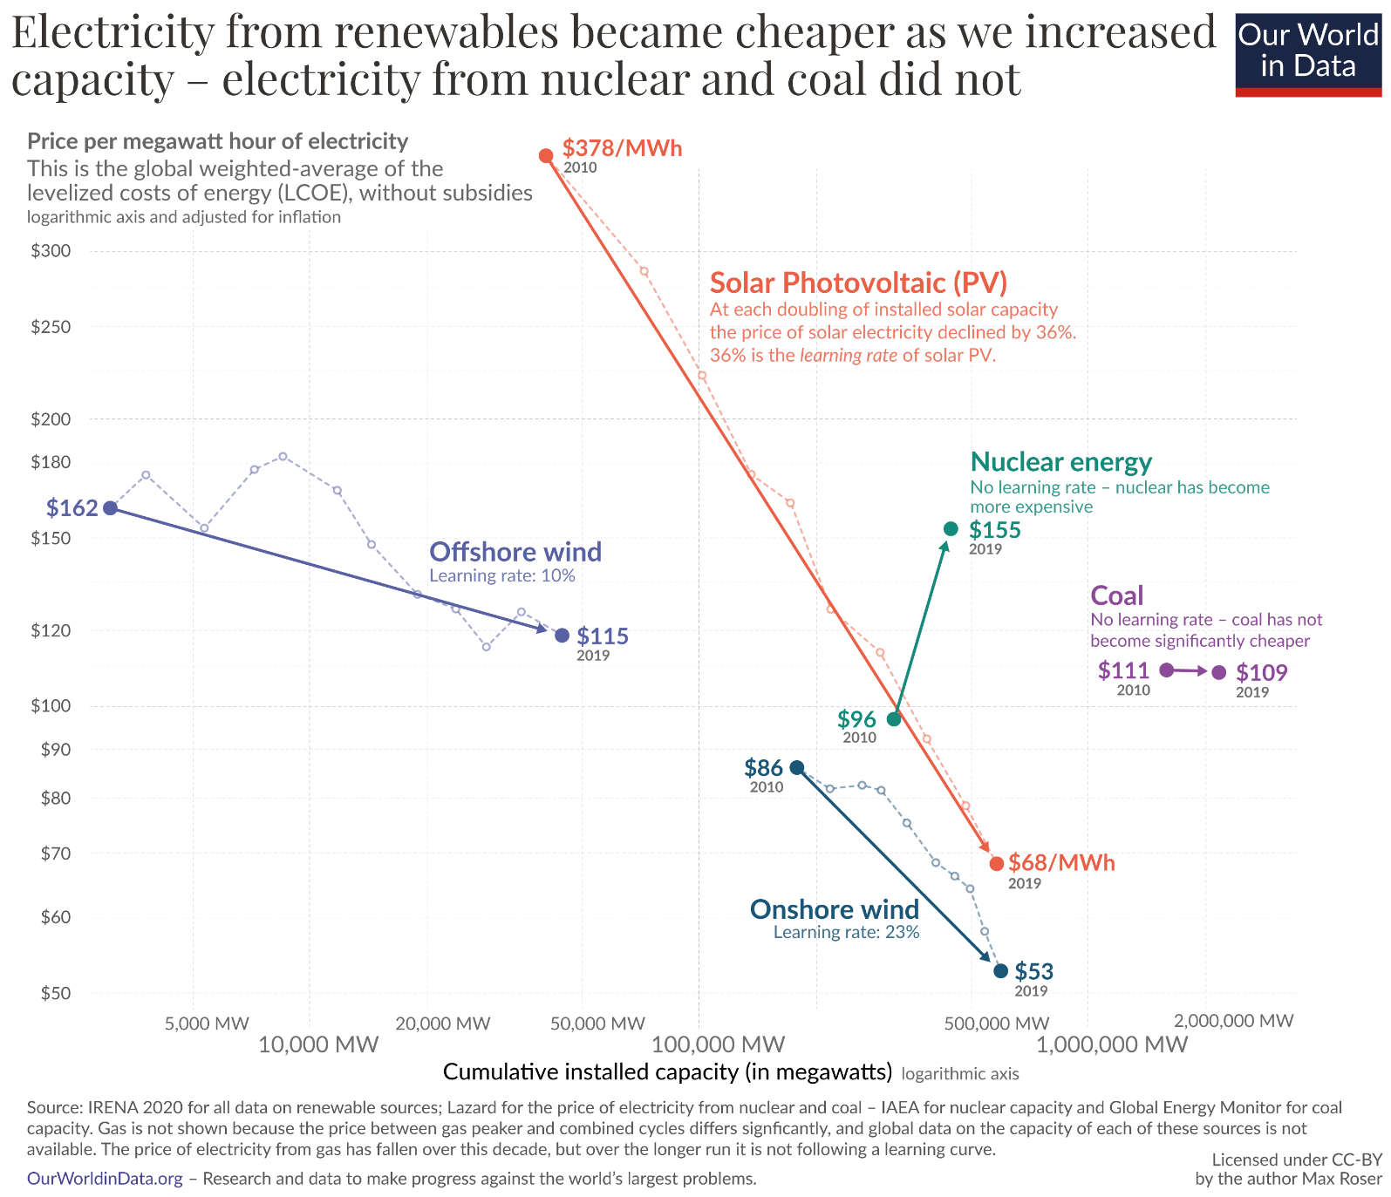




Renewables are getting cheaper faster than any other source, but…
Credence:
Economies of scale is more effective on renewables e.g. solar, wind
Grievance:
Grid-scale batteries cost increased 21% 2021-2022 (BloombergNEF), and will likely remain high
Logarithmic x-axis conceals diminishing returns in cost per increase in capacity
Only looks at a global scale and does not consider individual nations situations
Notes:
Well, renewables are getting cheaper faster than non-renewables thanks to economies of scale as both capacity expands and technology improves, so transitioning will be easier for everyone. However, storage batteries are getting more expensive, diminishing cost reductions are concealed by the logarithmic x-axis, and this applies only to global capacity which could overlook individual circumstances | such as

Slide 2

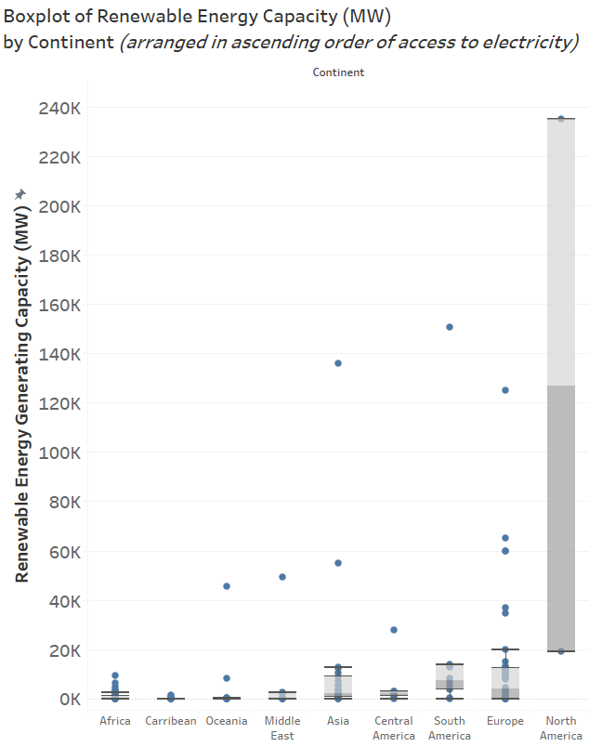
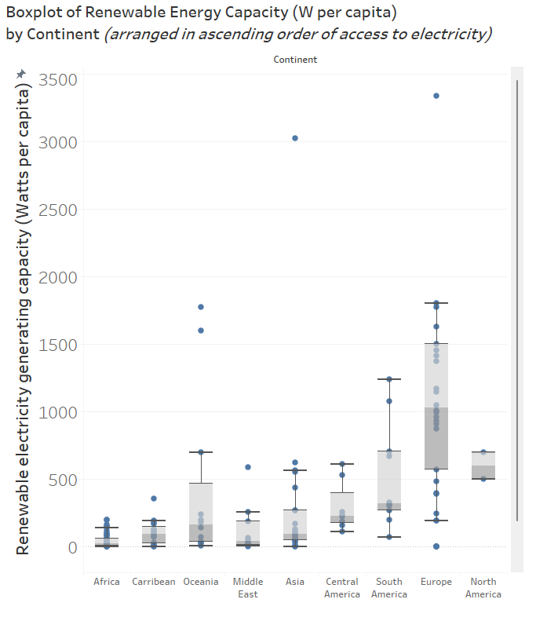
The effect of this benefit is dubious due to global inequalities in renewable capacity
China
(900k)
Notes:
such as existing inequalities between nations both in per capita and (more starkly) total terms. Hence, without energy imports or pooling, it is dubious whether the benefits of economies of scale apply equally | with high inaccess

Slide 3

The effect of this benefit is dubious due to global inequalities in renewable capacity
China
(900k)
Notes:
, with high inaccess regions facing more hardship than | their capacious counter parts

Slide 4

The effect of this benefit is dubious due to global inequalities in renewable capacity
China
(900k)
Notes:
Their capacious counterparts

Slide 5

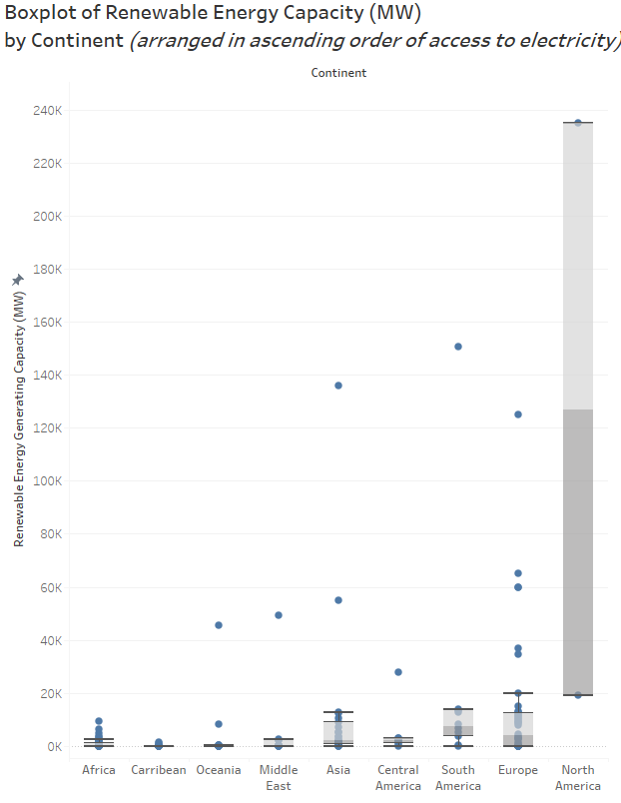
The effect of this benefit is dubious due to global inequalities in renewable capacity
China
(900k)
Notes:
How can we address this global two-speed problem?

